Slide 1


INT201 Decision, Computation and Language
Lecture 11 –Reducibility and Rice’s Theorem
Dr Yushi Li and Dr Chunchuan Lyu

Slide 2

Recap
Cantor’s Diagonalization Method
Church-Turing Thesis and Universal Turing Machine
Examples of decidable languages
Existence of undecidable language and non-Turing recognizable language
Today
Reducibility
The Halting Problem and other undecidable languages
Rice’s Theorem

Slide 3
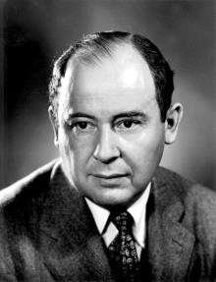
John von Neumann 1903-1957
Hungarian-American mathematician, physicist, computer scientist, engineer and polymath,
The axiomatic construction of general set theory (PhD thesis, 1925)
Private communication to Kurt Gödel about his independent
"Young man, in mathematics
discovery of the second theorem of incompleteness (1930)
Stopped working foundation of mathematics after 1931
Axiomatization of Quantum Physics and Functional Analysis
Mean Ergodic Theorem
Minimax Theorem and Duality in Linear Programming
Von Neumann Architecture, Merge Sort, Cellular Automata
The Computer and the Brain (1958) and Singularity
you don't understand things. You just get used to them."

Slide 4















Undecidable Problems
Definition
Undecidable problem. The associated language of a problem cannot be recognized by a TM that halts for all inputs.
Unrecognizable problem. The associated language of a problem cannot be recognized
by a TM.
The languages of TMs are undecidable but recognizable
L_{TM} = { M, w : M is a Turing machine that accepts the string w}
We consider undecidable problems unsolvable (informal).
Say the TM has run 6 weeks without giving a response. It is possible that it is not in the language, but it is also possible it is in the language and we only need to wait longer.
For decidable languages, there is an upper bound of the waiting time. For undecidable languages, the waiting has no time limit.

Slide 5






































Reducibility
Definition
Reduction is a way of converting one problem to another problem, so that the solution to the second problem can be used to solve the first problem.
If A reduces to B, then any solution of B solves A (Reduction always involves two
problems, A and B).
If A is reducible to B, then A cannot be harder than B.
If A is reducible to B and B is decidable, then A is also decidable.
If A is reducible to B and A is undecidable, then B is also undecidable.

Slide 6









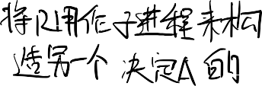







Reducibility
A common strategy for proving that a language L is undecidable is by reduction method, proceeding as follows:
Typical approach to show L is undecidable via reduction from A to L:
Find a problem A known to be undecidable
Suppose L is decidable.
Let R be a TM that decides L.
Using R as subroutine to construct another TM S that decides A.
But A is not decidable.
Conclusion: L is not decidable.

Slide 7
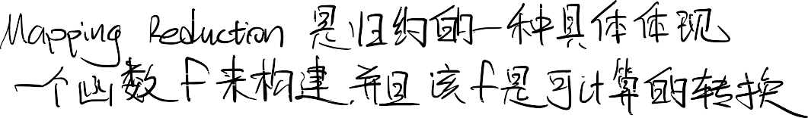







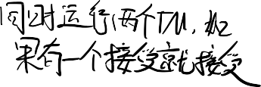



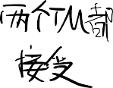
Mapping Reduction
Definition
Suppose that A and B are two languages
A is defined over alphabet Σ∗, so A ⊆ Σ∗
1 1
B is defined over alphabet Σ∗ , so B ⊆ Σ∗
2 2
Then A is mapping reducible to B, written
A ≤_{m} B
if there is a computable (Turing Machine can simulate through the tape) function
f : Σ∗ → Σ∗
1 2
such that, for every w ∈ Σ∗
1
w ∈ A ⇐⇒ f(w) ∈ B
The function f is called a reduction of A to B.

Slide 8








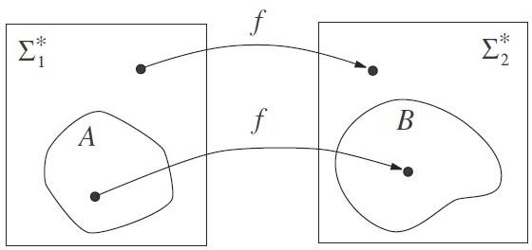

Mapping Reduction
w ∈ A ⇐⇒ f(w) ∈ B

Slide 9
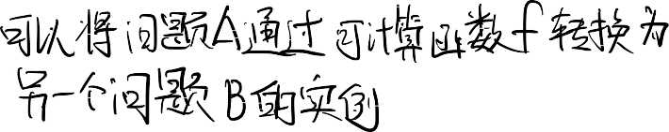


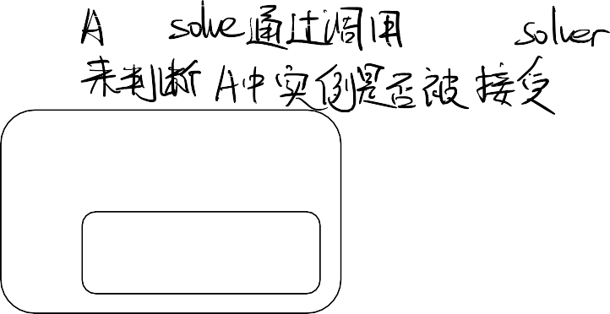


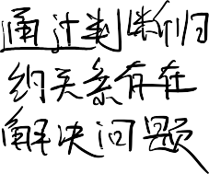

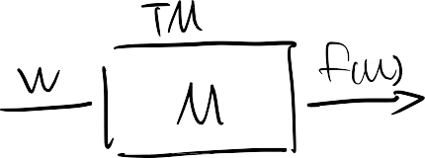
Mapping Reduction v.s. (General) Reduction
Mapping Reducibility of 𝐴 to 𝐵:
Translate 𝐴-questions to 𝐵-questions.
(General) Reducibility of 𝐴 to 𝐵:
Use 𝐵 solver to solve 𝐴.
𝐴 solver
𝐵 solver
w ∈ A ⇐⇒ f(w) ∈ B
Clearly, we can use mapping reduction
to construct general reduction.
By having A accepts w if B accepts f(w), rejects w if B rejects f(w) and loops if B loops on f(w).

Slide 10
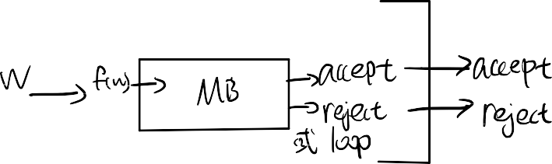

Mapping Reduction v.s. (General) Reduction
Mapping Reducibility of 𝐴 to 𝐵:
Translate 𝐴-questions to 𝐵-questions.
(General) Reducibility of 𝐴 to 𝐵:
Use 𝐵 solver to solve 𝐴.
𝐴 solver
𝐵 solver
w ∈ A ⇐⇒ f(w) ∈ B
However, we have other options such as A accepts when B rejects, calling B multiple times or computing while conditioning on the B solution.

Slide 11
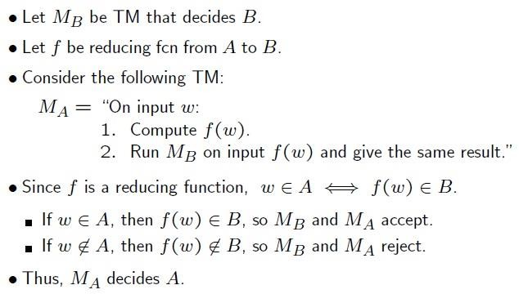


Theorem
If A ≤_{m} B and B is decidable, then A is decidable.
Proof
Corollary
If A ≤_{m} B and A is undecidable, then B is undecidable also.

Slide 12
Theorem
If A ≤_{m} B and B is Turing-recognizable, then A is Turing-recognizable.
Corollary
If A ≤_{m} B and A is not Turing-recognizable, then B is not Turing- recognizable.

Slide 13

Halting problem for TMs is undecidable
L_{TM} (acceptance problem for TMs) is undecidable, where
L_{TM} = { M, w | M is a TM and M accepts string w }
Define related problem:
HALT_{TM} = { M, w | M is a TM and M halts on string w }
L_{TM} and HALT_{TM} has same universe:
Ω={ M, w | M is TM, w is string}
Given a M, w ∈ Ω:
if M halts on input w, then M, w ∈ HALT_{TM},
if M doesn’t halt on input w, then M, w ∉ HALT_{TM}.

Slide 14











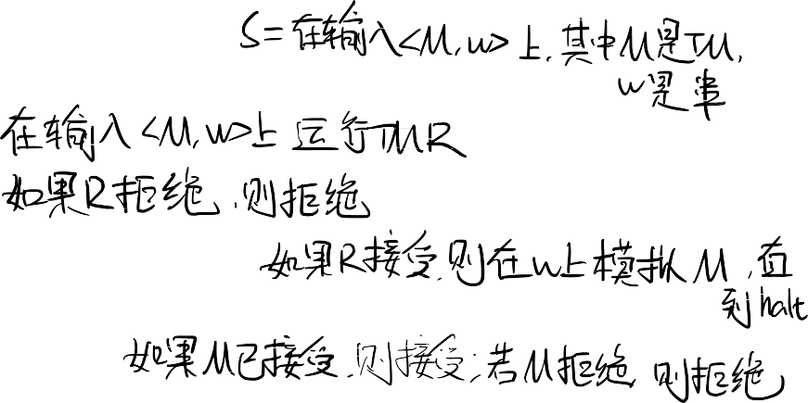
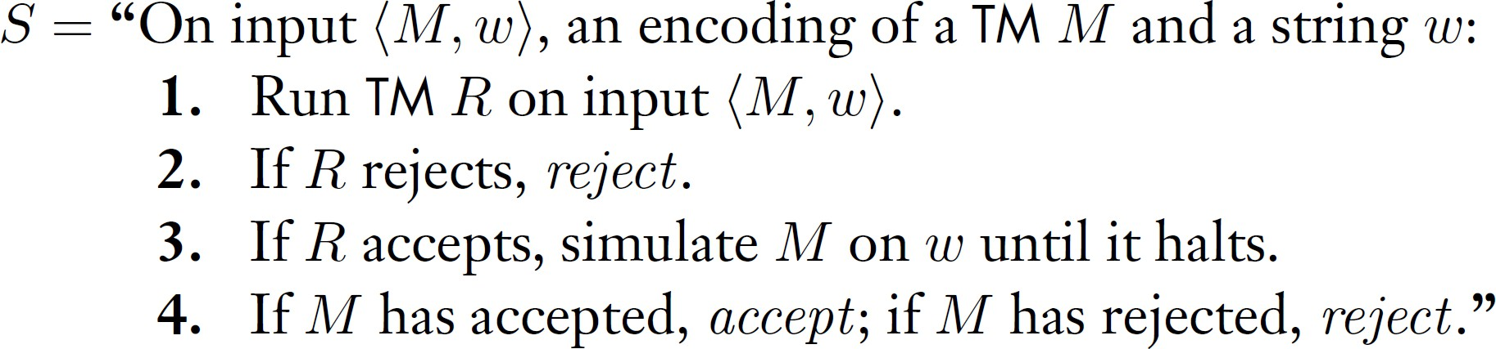
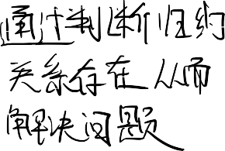

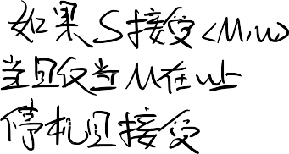





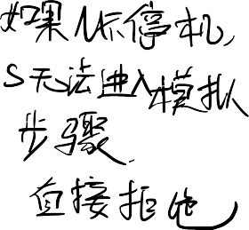


Halting problem for TMs is undecidable
Proof by general reduction from L_{TM}
We reduce L_{TM} to 𝐻𝐴𝐿𝑇_{𝑇𝑀}. We claim the following machine S decides L_{TM}
Clearly, S accepts <M,w> iff M halts on w and M accept w. S rejects, iff M loops on w or M halts and rejects w.
accept
accept
Halt_{TM}
𝑅
𝑆𝑖𝑚𝑢𝑙𝑎𝑡𝑒
𝑀 𝑜𝑛 𝑤
M,w
reject
reject
reject
reject
S
Now, as L_{TM} is undecidable, so must 𝐻𝐴𝐿𝑇_{𝑇𝑀}

Slide 15
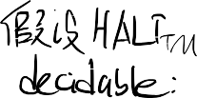
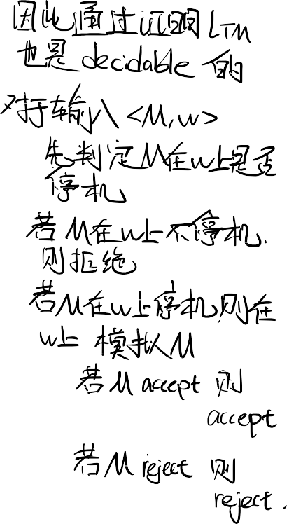

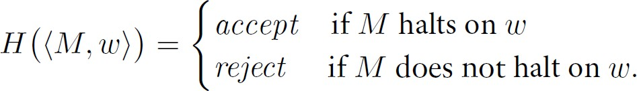
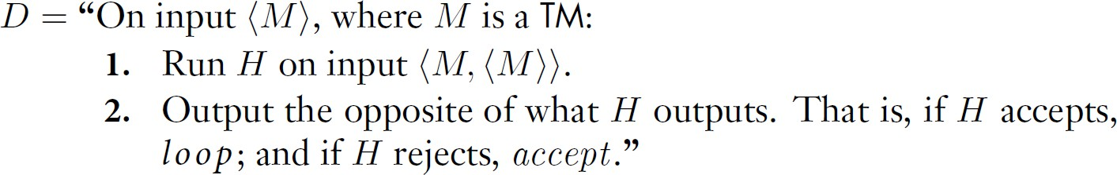


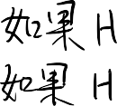
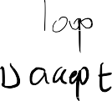


Halting problem for TMs is undecidable
Proof by contradiction
Assume halting is decidable, we have that TM H, where
Now, we use exactly the same strategy as in L_{TM} except we loop when we should reject, we have the following TM D:
We then ask, does D halts on <D>?
Clearly, if it halts, H accepts, then D loop.
If it does not halt, H rejects, then D accept (hence halt). We have a contradiction.

Slide 16


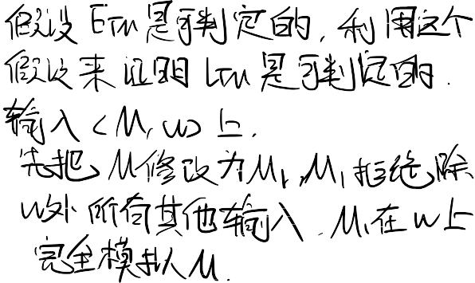

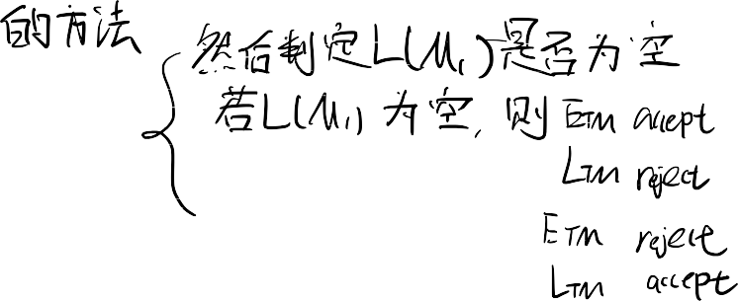



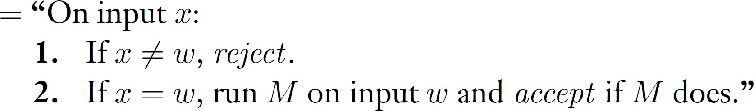
Emptiness of TMs is undecidable
𝐸_{𝑇𝑀} = {< 𝑀 > | 𝑀 𝑖𝑠 𝑎 𝑇𝑀 𝑎𝑛𝑑 𝐿(𝑀) = ∅}.
Intuitively, we need to show the Turing machine won’t enter the accept state for any strings. However, unlike the CFG/DFA cases, we find it hard to enumerate over all possible derivations.
Theorem: 𝐸_{𝑇𝑀} is undecidable.
Proof by reduction from A_{TM} :
For a given TM M and input w, we construct a TM M_{𝑤} s.t. 𝑀 accepts w iff L(M_{𝑤} ) ≠ ∅. We claim M_{𝑤}
If M accepts w, in step 1 M_{𝑤} rejects all strings other than w, and in step 2, M_{𝑤} accepts
it, and hence L(M_{𝑤} ) ≠ ∅.
If L(M_{𝑤} ) ≠ ∅, then as it rejects all strings other than w, and accepts w only when M accepts w. Therefore M accepts w.

Slide 17

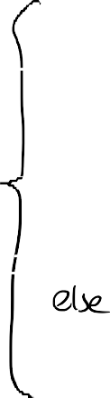





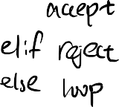


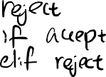


























Emptiness of TMs is undecidable
𝐸_{𝑇𝑀} = {< 𝑀 > | 𝑀 𝑖𝑠 𝑎 𝑇𝑀 𝑎𝑛𝑑 𝐿(𝑀) = ∅}.
Theorem: 𝐸_{𝑇𝑀} is undecidable.
Proof by reduction from L_{TM} :
M_{𝑤}
𝑀 accepts w iff L(M_{𝑤} ) ≠ ∅
Assume a decider for 𝐸_{𝑇𝑀} exists
^{L}TM
< M_{𝑤}>
reject
accept
M,w
^{𝐸}𝑇𝑀
reject
accept
But L_{TM} is undecidable, so must 𝐸_{𝑇𝑀}.

Slide 18
Other Undecidable Problems
Define T to be the set of all Turing machines descriptions, i.e.,
T = { M : M is a Turing machine}
𝐸_{𝑇𝑀} = {< 𝑀 > | 𝑀 𝑖𝑠 𝑎 𝑇𝑀 𝑎𝑛𝑑 𝐿(𝑀) = ∅}.
𝐼𝑁𝐹𝐼𝑁𝐼𝑇𝐸_{𝑇𝑀} =
< 𝑀 > 𝑀 𝑖𝑠 𝑎 𝑇𝑀 𝑎𝑛𝑑 𝐿 𝑀
= ∞}.
𝐿𝑇_{𝑇𝑀} =
< 𝑀 > 𝑀 𝑖𝑠 𝑎 𝑇𝑀 𝑎𝑛𝑑 𝐿 𝑀
= 𝐿 𝑇 }.
𝐹𝐼𝑁𝐼𝑇𝐸_{𝑇𝑀} =
< 𝑀 > 𝑀 𝑖𝑠 𝑎 𝑇𝑀 𝑎𝑛𝑑 ∃𝑛 ∈ 𝑁, 𝐿 𝑀
= 𝑛}.
𝐴𝐿𝐿_{𝑇𝑀} =
< 𝑀 > 𝑀 𝑖𝑠 𝑎 𝑇𝑀 𝑎𝑛𝑑 𝐿 𝑀 = Σ∗}
Is it possible to prove them all at once?

Slide 19
Non-trivial Properties and Rice’s Theorem
• | 𝐸_{𝑇𝑀} = {< 𝑀 > | 𝑀 𝑖𝑠 𝑎 𝑇𝑀 𝑎𝑛𝑑 𝐿(𝑀) = ∅}.
• | 𝐼𝑁𝐹𝐼𝑁𝐼𝑇𝐸_{𝑇𝑀} = < 𝑀 > 𝑀 𝑖𝑠 𝑎 𝑇𝑀 𝑎𝑛𝑑 𝐿 𝑀 = ∞}.
• | 𝐿𝑇_{𝑇𝑀} = < 𝑀 > 𝑀 𝑖𝑠 𝑎 𝑇𝑀 𝑎𝑛𝑑 𝐿 𝑀 = 𝐿 𝑇 }.
• | 𝐹𝐼𝑁𝐼𝑇𝐸_{𝑇𝑀} = < 𝑀 > 𝑀 𝑖𝑠 𝑎 𝑇𝑀 𝑎𝑛𝑑 ∃𝑛 ∈ 𝑁, 𝐿 𝑀 = 𝑛}.
• | 𝐴𝐿𝐿_{𝑇𝑀} = < 𝑀 > 𝑀 𝑖𝑠 𝑎 𝑇𝑀 𝑎𝑛𝑑 𝐿 𝑀 = Σ∗}
(Informal) Non-trivial properties in common:
none of them are empty set
none of them includes all Turing machines.
<M> ∈ P iff L(M) satisfy some properties,
i.e., P = < 𝑀 > 𝑀 𝑖𝑠 𝑎 𝑇𝑀 and p(L(M))==1} where 𝑝: 𝐿 𝑀 |𝑀 ∈ 𝑇
→ 1,0
(Informal) Rice’s Theorem:
Any non-trivial property of Turing machines is undecidable

Slide 20








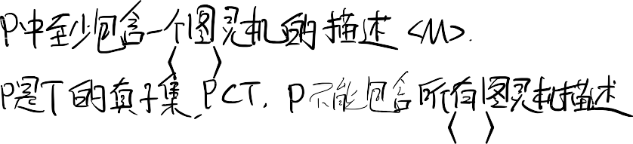
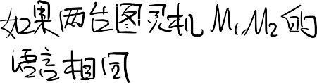





Rice’s Theorem
Define T to be the set of all Turing machines descriptions, i.e.,
T = { M : M is a Turing machine}
Let P be a subset of T such that
P ≠ ∅, i.e., there exists a Turing machine M such that M ∈ P,
P is a proper subset of T , i.e., there exists a Turing machine N such that
for any two Turing machines M₁ and M₂ with L(M₁) = L(M₂),
N ∉ P,
either both M₁ and M₂ are in P or
none of M₁ and M₂ is in P. Then the language P is undecidable.
This is a more operational for checking the condition than
∃ 𝑝: 𝐿 𝑀 |𝑀 ∈ 𝑇 → 1,0 ,
such that M ∈ P iff 𝑝(𝐿(𝑀)) = 1.

Slide 21





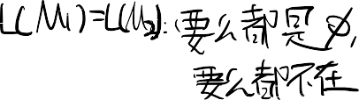


Rice’s Theorem and Applications
Let P be a subset of T such that
1. P ≠ ∅,
P is a proper subset of T ,
for any two Turing machines M₁ and M₂ with L(M₁) = L(M₂),
either both M₁ and M₂ are in P or
none of M₁ and M₂ is in P.
𝐸_{𝑇𝑀} = < 𝑀 > 𝑀 𝑖𝑠 𝑎 𝑇𝑀 𝑎𝑛𝑑 𝐿 𝑀 = ∅}.
A TM rejects all inputs will suffice is in the set.
A TM accepts all inputs is not in the set.
If L(M₁) = L(M₂), they are both either ∅ or non-empty, either both in the set or not in the set respectively.
Therefore 𝐸_{𝑇𝑀} is undecidable by Rice’s theorem
21

Slide 22
Rice’s Theorem and Applications
Let P be a subset of T such that
1. P ≠ ∅,
P is a proper subset of T ,
for any two Turing machines M₁ and M₂ with L(M₁) = L(M₂),
either both M₁ and M₂ are in P or
none of M₁ and M₂ is in P.
𝐼𝑁𝐹𝐼𝑁𝐼𝑇𝐸_{𝑇𝑀} = < 𝑀 > 𝑀 𝑖𝑠 𝑎 𝑇𝑀 𝑎𝑛𝑑 𝐿 𝑀 = ∞}.
A TM accepts all inputs will suffice is in the set.
A TM rejects all inputs is not in the set.
If L(M₁) = L(M₂), |L(M₁)| = |L(M₂)| so they are both either infinite or finite, either both in the set or not in the set respectively.
Therefore 𝐼𝑁𝐹𝐼𝑁𝐼𝑇𝐸_{𝑇𝑀} is undecidable by Rice’s theorem
22

Slide 23
Rice’s Theorem and Applications
Let P be a subset of T such that
1. P ≠ ∅,
P is a proper subset of T ,
for any two Turing machines M₁ and M₂ with L(M₁) = L(M₂),
either both M₁ and M₂ are in P or
none of M₁ and M₂ is in P.
𝐼𝑁𝐹𝐼𝑁𝐼𝑇𝐸_{𝑇𝑀} = < 𝑀 > 𝑀 𝑖𝑠 𝑎 𝑇𝑀 𝑎𝑛𝑑 𝐿 𝑀 = ∞}.
Note that there might be 𝑴_{𝟏}, 𝑴_{𝟐} ∈ 𝑰𝑵𝑭𝑰𝑵𝑰𝑻𝑬_{𝑻𝑴} but L(𝑴_{𝟏}) ≠ L(𝑴_{𝟐})

Slide 24











Rice’s Theorem and Non-Applications
Let P be a subset of T such that
1. P ≠ ∅,
P is a proper subset of T ,
for any two Turing machines M₁ and M₂ with L(M₁) = L(M₂),
either both M₁ and M₂ are in P or
none of M₁ and M₂ is in P.
𝐹𝐼𝑉𝐸_{𝑇𝑀} = < 𝑀 > 𝑀 𝑖𝑠 𝑎 𝑇𝑀 𝑎𝑛𝑑 𝑀 ℎ𝑎𝑠 5 𝑠𝑡𝑎𝑡𝑒𝑠}.
We cannot apply Rice’s theorem here, as clearly we can have a UTM with 3 states recognize the same language as a given 5 states TM by simulating that machine.
In general, a property is about the language not about the TMs

Slide 25






















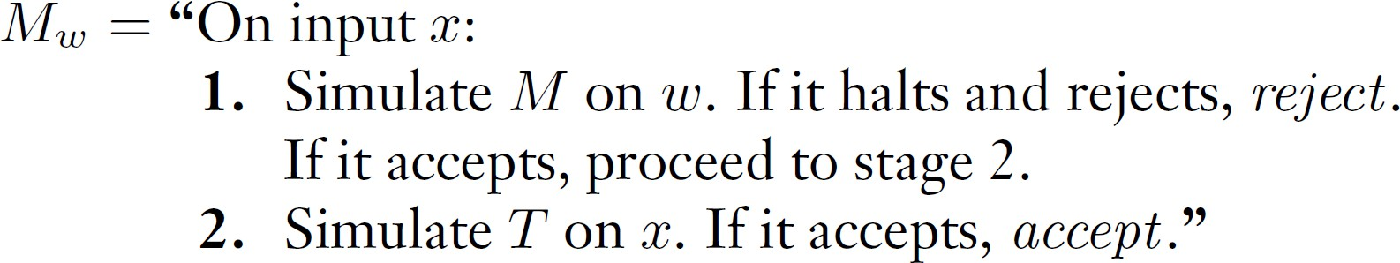
Rice’s Theorem and Proof
Rice’s Theorem
Let P be a proper non-empty subset of TM descriptions such that for M₁ and M₂
with L(M₁) = L(M₂), M₁ ∈ 𝑃 iff M₂ ∈ 𝑃. Then, P is undecidable.
Proof attempt by reduction from L_{TM} :
We will reduce L_{TM} to all non-trivial property problems. Denote any given problem P, we have a decider 𝐑_{𝑷} and a Turing machine T such that <T> ∈ 𝐏. For a given TM M and input w, ideally we construct a TM M_{𝑤} s.t. 𝑀 accepts w iff < M_{𝑤} > ∈ 𝑃.
(T)

Slide 26
Rice’s Theorem and Proof
Proof attempt by reduction from L_{TM} :
𝑀 accepts w →
< M_{𝑤}(𝑇) > ∈ 𝑃.
(T)
If 𝑀 accepts 𝑤, we have L(M_{𝑤}(T))=L(T). As <T> ∈ 𝑃, we have < M_{𝑤}(𝑇) > ∈ 𝑃.
If 𝑀 rejects or loops on 𝑤, we have L(M_{𝑤}(T))= ∅. Now < M_{𝑤} (𝑇)> ∉ 𝑃 iff Turing machines with empty language is not in the property.
Obviously, this is not true for all property.
Can we do something differently when empty language is not in the property?

Slide 27
Rice’s Theorem and Proof
Proof by reduction from L_{TM} :
(T)
Take any P, let M∅ be a TM such that 𝐿(M∅) = ∅. If < M∅ >∈ 𝑃, we use its’ complement 𝑃^{ത}.
Obviously, P is a decider iff 𝑃^{ത} is a decider.
Moreover, there always exists < 𝑇^{ത} > ∈ 𝑃^{ത} as P is a proper subset.
If 𝑀 accepts 𝑤, we have L(M_{𝑤}(𝑇^{ത} ))=L(𝑇^{ത} ). As < 𝑇^{ത} > ∈ 𝑃, we have < M_{𝑤} > ∈ 𝑃^{ത}.
If 𝑀 rejects or loops 𝑤, we have L(M_{𝑤}(𝑇^{ത} ))= ∅. As we have < M∅ >∈ 𝑃, so < M_{𝑤}(𝑇^{ത} ) >∉ 𝑃^{ത}
So, we have if < M∅ >∈ 𝑃 , 𝑀 accepts w iff < M_{𝑤}(𝑇^{ത}) > ∈ 𝑃^{ത}.

Slide 28
Rice’s Theorem and Proof
Proof by reduction from L_{TM} :
(T)
In all, we have the following results:
If < M∅ >∉ 𝑃 , 𝑀 accepts w iff < M_{𝑤}(𝑇) > ∈ 𝑃. If < M∅ >∈ 𝑃 , 𝑀 accepts w iff < M_{𝑤}(𝑇^{ത}) > ∈ 𝑃^{ത}.

Slide 29








Rice’s Theorem and Proof
If < M∅ >∉ 𝑃 , 𝑀 accepts w iff < M_{𝑤}(𝑇) > ∈ 𝑃. If < M∅ >∈ 𝑃 , 𝑀 accepts w iff < M_{𝑤}(𝑇^{ത}) > ∈ 𝑃^{ത}.
Proof by reduction from L_{TM} :
(T)
^{L}TM
If < M∅
accept
accept
>∉ 𝑃, < M_{𝑤}(𝑇) >
𝑅_{𝑃}
reject accept
reject accept
M,w
If < M∅ >∈ 𝑃, < M_{𝑤} (𝑇^{ത}) >
𝑅_{𝑃}ത
reject
reject
Now, as L_{TM} is undecidable, so must all the non-trivial properties.

Slide 30
Quick review
Reducibility shows a problem can only be reduced to problems that is at least as hard as itself.
The Halting Problem and other undecidable languages
Rice’s Theorem states non-trivial properties is undecidable

Slide 31




THANK YOU
31

